Slide 1
Capstone Engagement
Assessment, Analysis, and Hardening of a Vulnerable System

Slide 2
Table of Contents
This document contains the following sections:
01
Network Topology
02
Red Team: Security Assessment
03
Blue Team: Log Analysis and Attack Characterization
Hardening: Proposed Alarms and Mitigation Strategies
04

Slide 3
Network Topology
‹#›

Slide 4
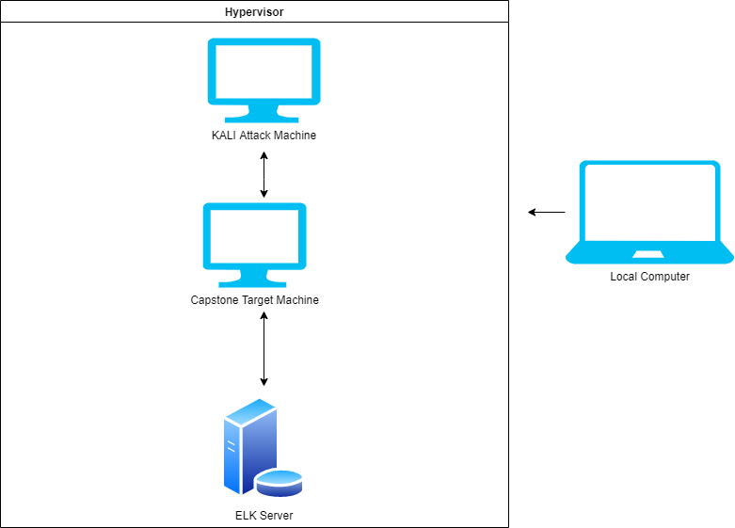
Network Topology
Network
Address Range:
192.168.1.0/24
Netmask: 255.255.255.0
Gateway: 192.168.1.0
Machines
IPv4: 192.168.1.1
OS: Windows
Hostname: Hypervisor
IPv4: 192.168.1.100
OS: Ubuntu 18.04
Hostname: ELK
IPv4: 192.168.1.90
OS: Kali
Hostname: Kali
IPv4: 192.168.1.105
OS: Ubuntu
Hostname: Capstone

Slide 5

Red Team
Security Assessment
‹#›

Slide 6
Recon: Describing the Target
Nmap identified the following hosts on the network:
Hostname | IP Address | Role on Network
Hyper-V Azure Machine | 192.168.1.1 | Host Machine
Kali | 192.168.1.90 | Attacking Machine
ELK stack | 192.168.1.100 | Network Monitor (Kibana)
Capstone | 192.168.1.105 | Target Machine

Slide 7
Vulnerability Assessment
The assessment uncovered the following critical vulnerabilities in the target:
Vulnerability | Description | Impact
Weak Passwords | Common and simplistic passwords without the use of symbols, numbers, or capital letters | Attackers may use wordlists such as rockyou.txt to crack these commonly used passwords
Hashed Passwords | Hashed passwords without prior salting can easily be cracked using browser based tools (crackstation.net) or programs (hashcat) | Attackers with proper credentials will be able to access the system and its content
User credentials found on separate account | Another user’s credentials are stored (in plain text) on a separate individual’s account | User Ashton had Ryan’s name and password hash stored in her account, allowing attackers to exploit Ryan as well.
WebDAV Vulnerability | WebDAV not configured properly | Attackers are able to gain shell access and modify website content

Slide 8
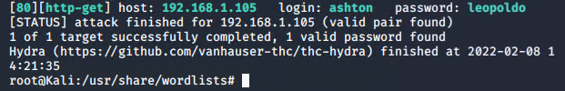
Exploitation: Weak Passwords
01
02
Tools & Processes
Hydra and wordlist rockyou.txt used to gain Ashton’s password
( hydra -l ashton -P /root/Downloads/rockyou.txt -s 80 -f 192.168.1.105 http-get /company_folders/secret_folder)
Achievements
Ashton’s password was cracked
Password: leopoldo
03

Slide 9
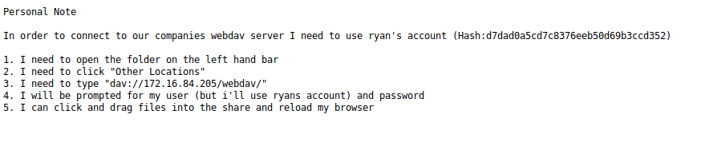
Exploitation: Credentials found on separate account
01
02
Tools & Processes
Once entering Ashton’s account, I was able to find user Ryan’s account information
Achievements
I was able to retrieve a personal note containing Ryan’s account hash and instructions on how to achieve access to the browser
03

Slide 10
Exploitation: Hashed Passwords
01
02
Tools & Processes
Crackstation.net was used to crack user Ryan’s hashed password
Achievements
Password: linux4u
This was used to gain access to the browser
03

Slide 11
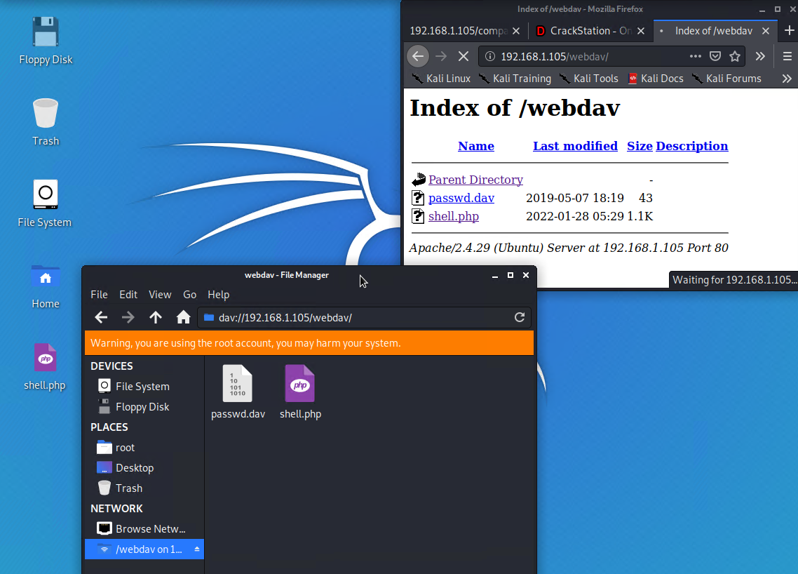

Slide 12
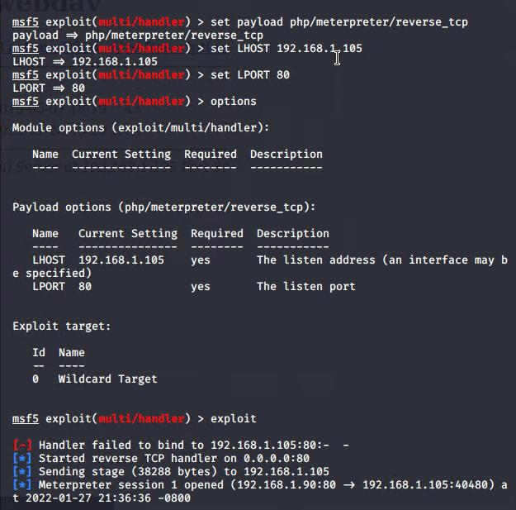
Exploitation: WebDAV
01
03
Tools & Processes
Using msfvenom and meterpreter to deliver a payload on the target machine
02
Achievements
With the multi/handler exploit, I was able access the target’s shell

Slide 13

Blue Team
Log Analysis and Attack Characterization
‹#›

Slide 14

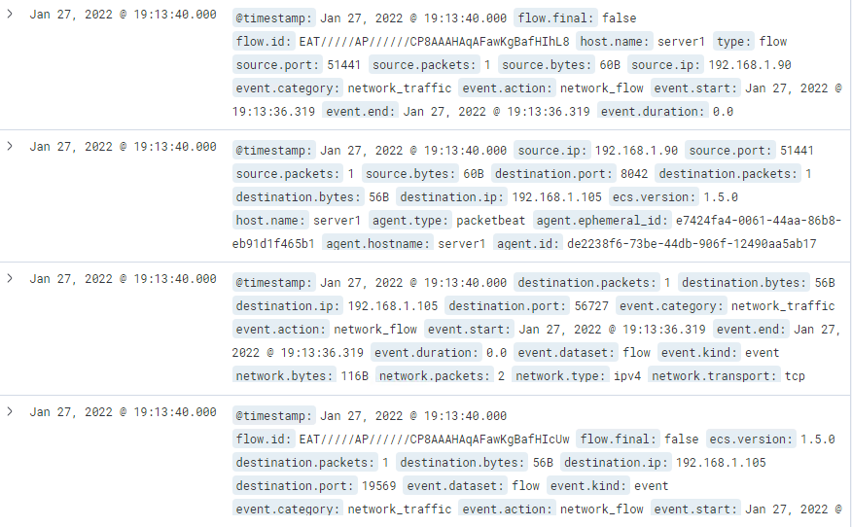
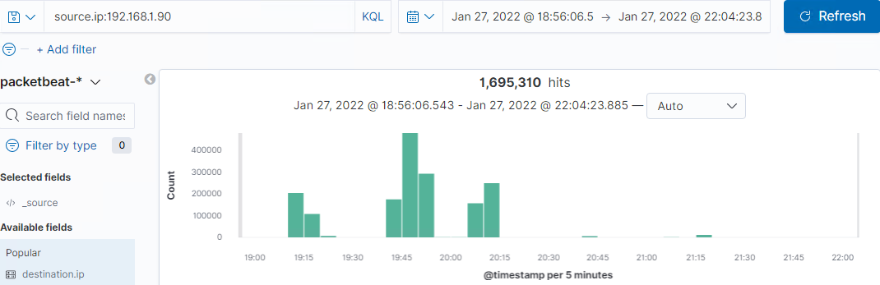
Analysis: Identifying the Port Scan
Port scan occurred on Jan 27, 2022 at 7:13:40 pm
A total of 1,695,310 packets were sent from source IP 192.168.1.90
Event category and action would indicate network traffic and flow has been established by unknown IP

Slide 15
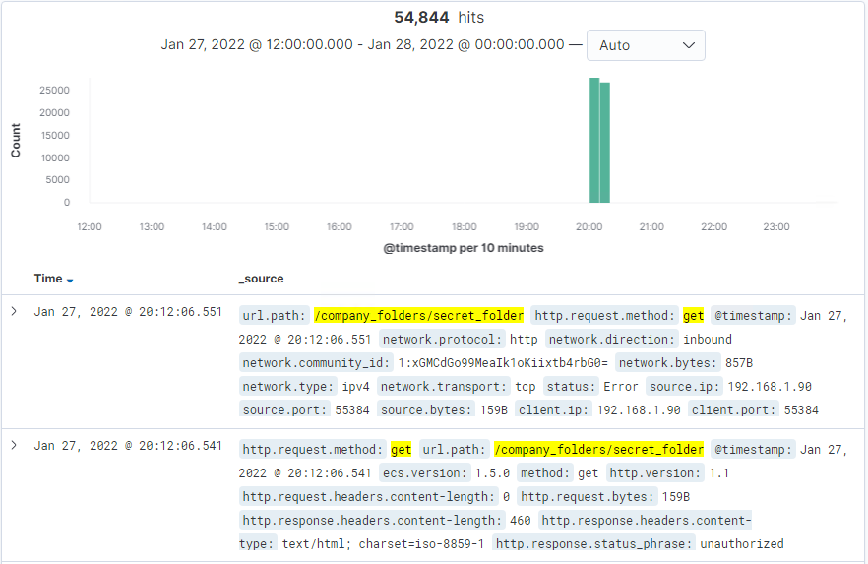
Analysis: Finding the Request for the Hidden Directory
GET requests for /company/secret folder started at 8:06:47 pm with a total of 54,844 hits
Doc file connect_corp_server was requested. The file contains instructions on accessing the web browser using Ryan’s credentials

Slide 16
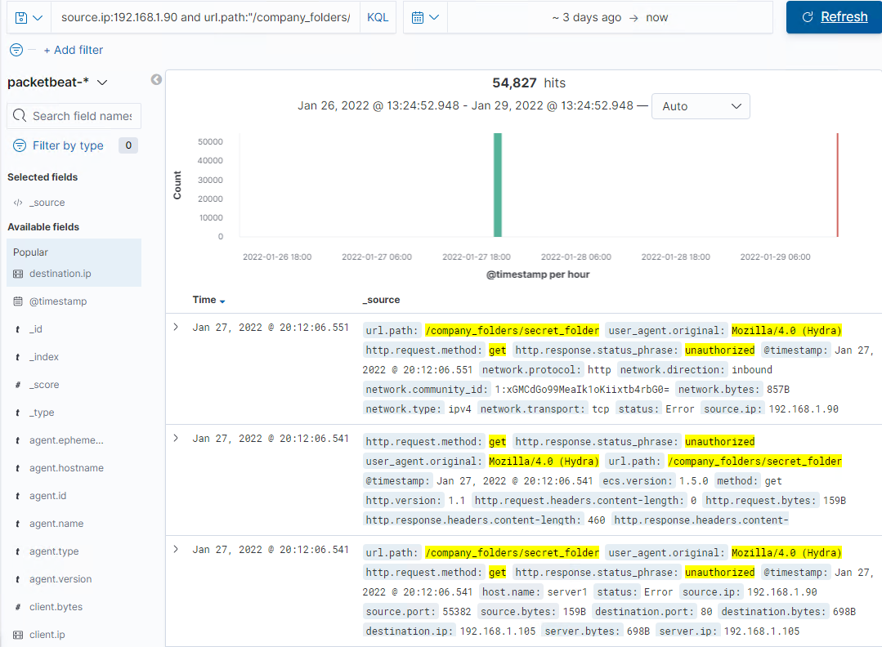
Analysis: Uncovering the Brute Force Attack
54,844 GET requests were made with a response status of unauthorized. This would indicate the amount of failed request that were made before the attacker was successful

Slide 17
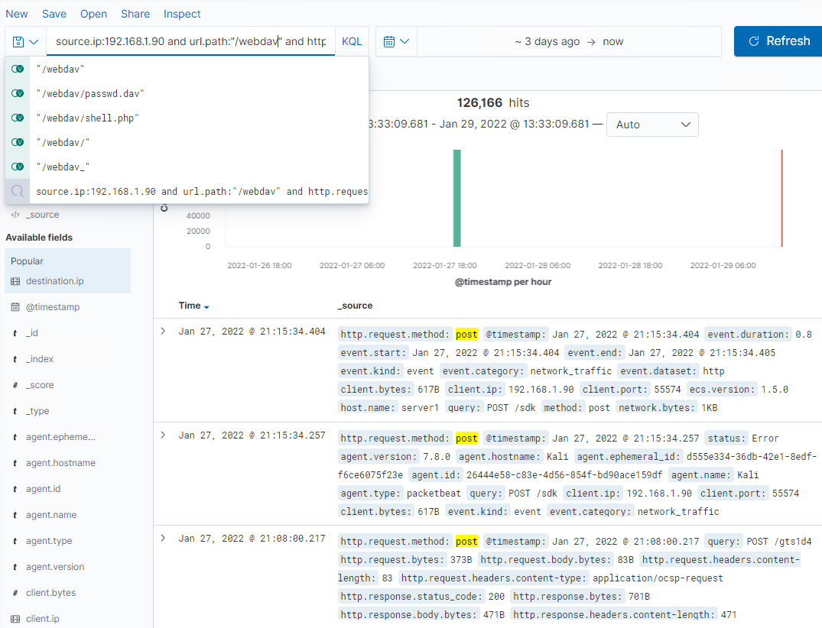
Analysis: Finding the WebDAV Connection
A total of 126,166 requests were made for /webdav
Files included were passwd.dav and shell.php (which were POST requests)

Slide 18
Blue Team
Proposed Alarms and Mitigation Strategies
‹#›

Slide 19
Mitigation: Blocking the Port Scan
When traffic from an unknown IP is detected
Over 10,000 connections within an hour from a unknown IP should raise an alarm
Create a whitelist of IPs that are approved to send and receive traffic
IPs not on the whitelist that are trying to establish a connection to the server must be further authenticated or investigated
Have regular system port scans to detect any open ports and monitor accordingly

Slide 20
Mitigation: Finding the Request for the Hidden Directory
An alarm should be put forth when unauthorized (unknown source IPs) access requests are being made
When over 3 failed attempts at accessing hidden folders and files occur, the team should be notified
Rename folders such as “/secret_folder” to lessen exposure and attention
Encrypt sensitive content within these folders
Request appropriate credentials when accessing any directory of file past “/company-folders/”. This would provide an extra roadblock against attackers

Slide 21
Mitigation: Preventing Brute Force Attacks
When an unusually high number of HTTP response status: Unauthorized have occurred, an alarm should be triggered.
When over five 401 errors have occurred an alarm should be triggered. These errors indicate a possible brute force attack
Have a password policy that would require users to come up with more complex passwords
Policy can be a requirement of at least one special character, capital letter, and number. Passwords must exceed 10 letters/symbols
Lock out a user account after 5 failed login attempts for an hour

Slide 22
Mitigation: Detecting the WebDAV Connection
Assuming that a Whitelist of IPs will be made, an alarm should be triggered when HTTP get requests are made from an unknown IP attempting to access “/webDAV”
Regularly updating and managing a Whitelist of trusted IPs is essential to ensure access is limited.
A possible firewall policy that would deny any access from IPs outside the Whitelist can be deployed

Slide 23
Mitigation: Identifying Reverse Shell Uploads
An alarm should be triggered anytime a HTTP method: POST has occurred within “/webDAV”
Have a team regularly check what is behind each POST
When something is being uploaded, authorized individuals should know of it beforehand as any alteration of the browser should be planned
Limit IPs that are allowed to upload. Others with limited access should only have read only access

